Slide 1

Language Translator using Google API
Review - 2
Date : 20-02-24
1CR21CS151 Rohan N Karnkoti
1CR21CS214 Vismitha S
Under the guidance of:
Mrs. Manjula Subramaniam
Department of Computer Science & Engineering
Notes:
1

Slide 2
Language Translator using Google API
TITLE

Slide 3
PROBLEM STATEMENT
Develop a python project which does language translator using Google API. Use any native language

Slide 4
DETAILED REQUIREMENTS
Knowledge of Python
Understanding of Google API
Understanding of tkinter library to take in voice input and display output.
Understanding of googletrans and speech_recognition libraries.

Slide 5
SOFTWARE TOOLS USED
Visual Studio Code
Git
GitHub
Python 3.11
Tkinter library
Googletrans library
Speech_recognition library
Gtts library

Slide 6
PROPOSED SOLUTION
Graphical User Interface (GUI): Create a basic GUI using tkinter with a single button (e.g., microphone symbol) to initiate voice input.
Voice Input: Implement voice input using the speech_recognition library when the user clicks the microphone button.
Translation: Utilize the googletrans library to translate the captured voice input into a target language.
Text-to-Speech Output: Use the gTTS library to convert the translated text into speech for output.

Slide 7
PROPOSED SOLUTION
Asynchronous Processing: Implement threading to ensure the GUI remains responsive during voice capture and translation.
Error Handling: Handle potential errors during voice recognition and translation to provide a smooth user experience.
Dynamic Language Selection: Allow users to dynamically select the target language (e.g., through a dropdown or input).
User Feedback: Provide clear feedback to the user, such as displaying the translated text on the GUI and potentially using visual indicators for the translation process.

Slide 8
TOTAL HOUR & WORKS
This project will require around 40 days.
20 days for one person.

Slide 9
DESIGN
User Interface:
Microphone Button: Allows users to trigger voice input.
Language Dropdown: Enables users to select the target language for translation.
Output Label: Displays the translated text to the user.
Translation Process:
Speech Recognition: Utilizes the speech_recognition library to convert speech input into text.
Language Detection: Determines the language of the input text using the googletrans library.
Translation: Translates the input text into the selected target language using the googletrans library.
Text-to-Speech Conversion: Converts the translated text into speech using the gtts library.

Slide 10
IMPLEMENTATION
Libraries Used:
tkinter: for building the graphical user interface.
googletrans: for language detection and translation.
speech_recognition: for converting speech input to text.
gtts: for converting text to speech.
Classes and Functions:
LanguageTranslator Class: Contains methods for speech recognition, translation, and text-to-speech conversion.
TranslatorApp Class: Constructs the GUI and handles translation operations.
Main Function: Initializes the application and starts the main event loop.

Slide 11
Workflow:
The user clicks the microphone button to start voice input.
The application listens for speech input using the speech_recognition library.
The recognized text is sent for language detection to determine the source language.
The detected language is used to translate the text into the selected target language.
The translated text is displayed on the GUI and converted into speech for the user.

Slide 12
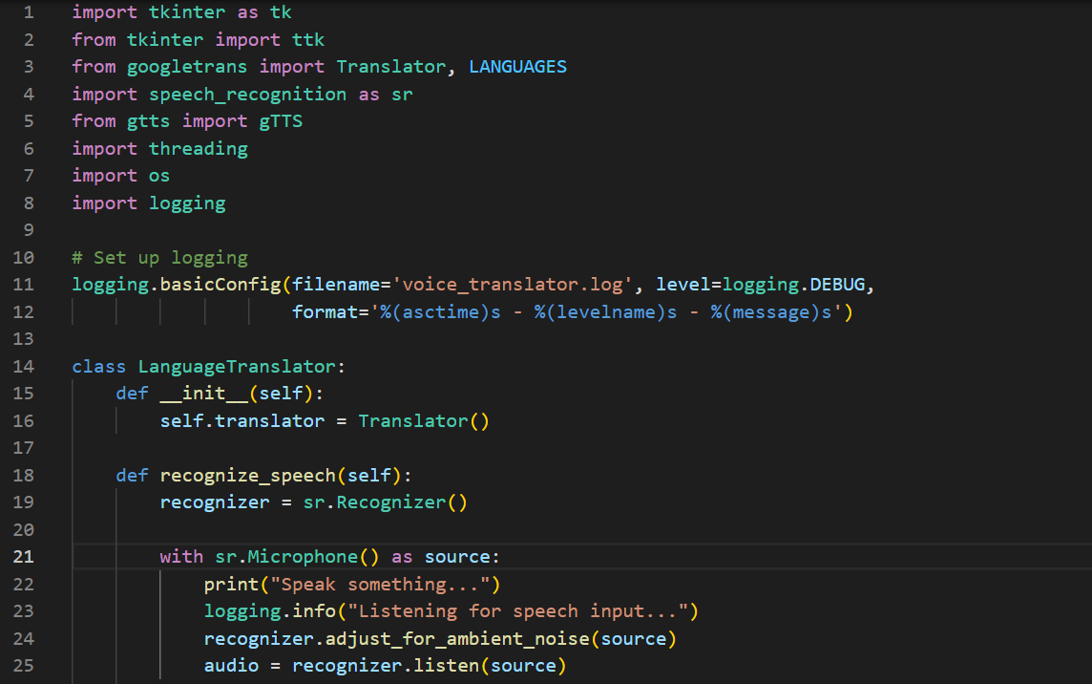
SOURCE CODE

Slide 13
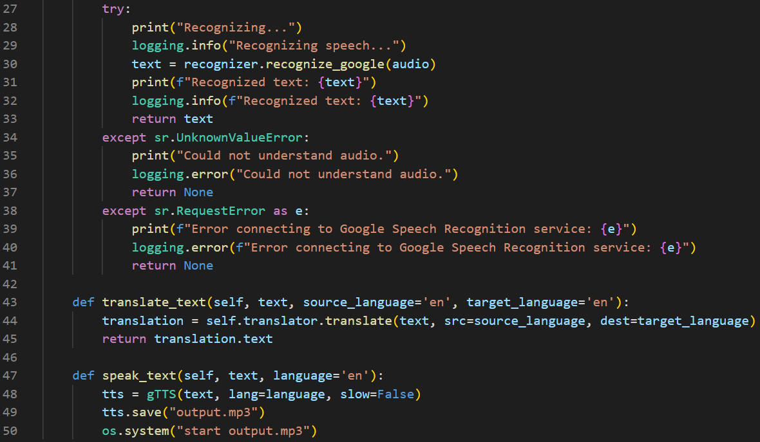

Slide 14
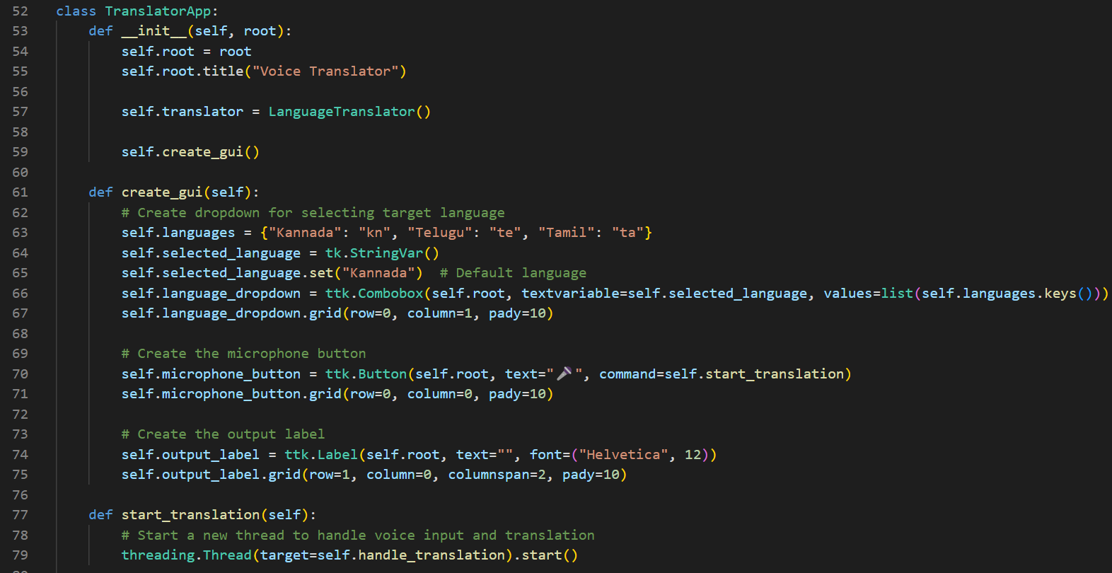

Slide 15
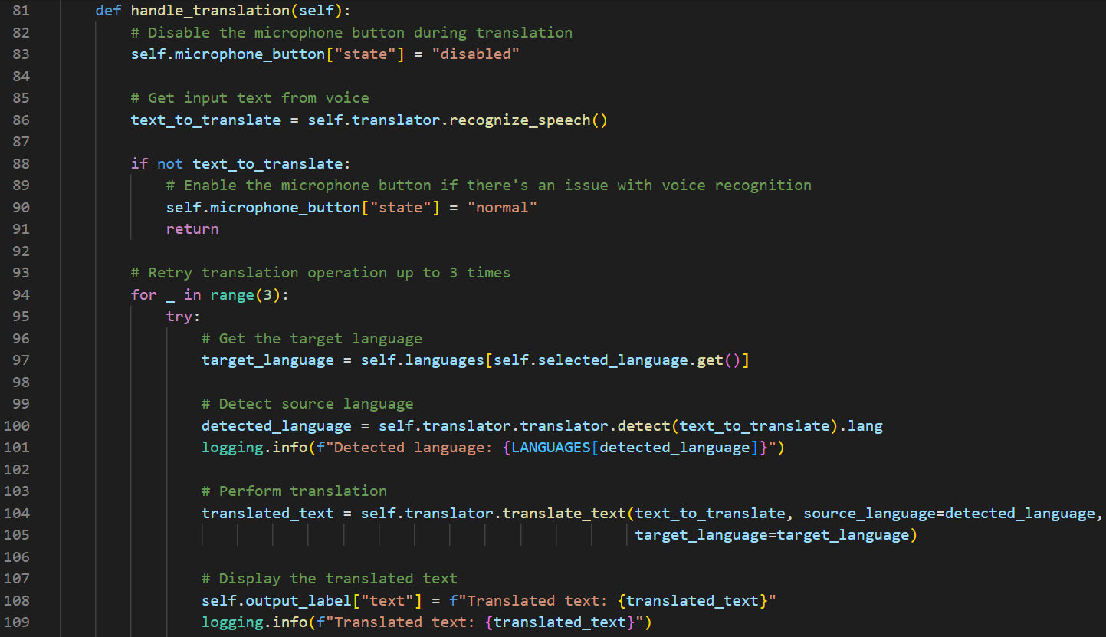

Slide 16
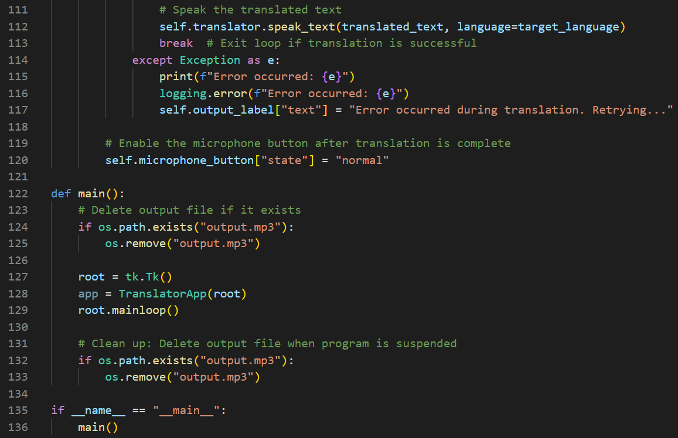

Slide 17
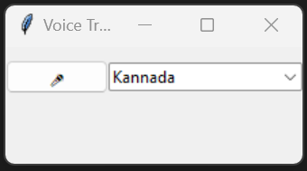
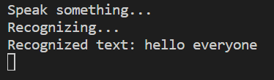
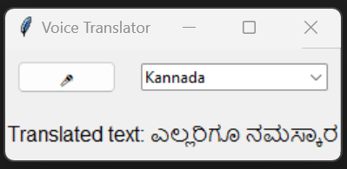
OUTPUT

Slide 18
Thank you

